Slide 1
Modelling and Simulation

Slide 2
Modelling and Simulation
A model is a representation of a physical system or process.
Models are used to simulate what is happening in the system that the model represents.
These simulations allow us to gain knowledge and make predictions about the environment in a way that is frequently safer, cheaper and faster than conducting real world experiments.
Computer models are software implementations that represent a real or virtual problem.

Slide 3
Example: COVID-19
Public Health professional used models to predict how social distancing and other measures might reduce the rate of infection.
The results of these simulations informed government policy in many places.
In Ireland, there was an Irish Epidemiological Modelling Advisory Group to NPHET.
This group was involved in developing mathematical and statistical models for each stage of the pandemic. These models were used to plan healthcare demand and investigate the impact of actions to reduce the spread of the virus.
https://www.ucd.ie/research/covid19response/news/irishepidemiologicalmodellingadvisorygrouptonphet/

Slide 4
Basic Models
Dice - Complete 2 Tasks

Slide 5
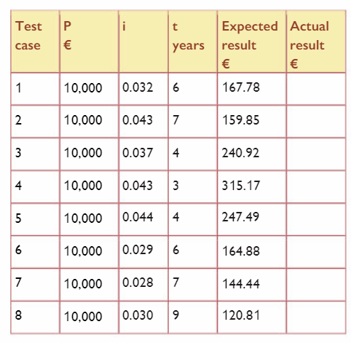
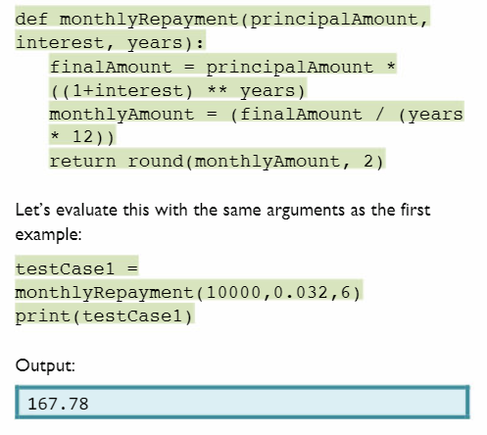
Evaluating Basic Models
It is important to evaluate models using test cases
Compound Interest Example

Slide 6
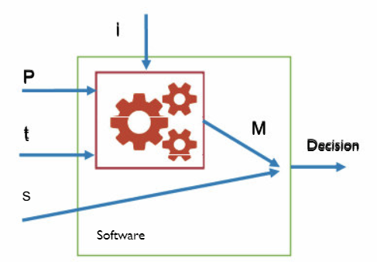
Evaluating Models
This model could be used to assess the suitability of the loan for a person based on their salary.
This decision could be embedded into the code.
The user could enter
The loan amount (P)
The loan term (t)
Their monthly salary (s)
The program will approve/decline the loan if the loan amount is less than 30% of the person’s salary

Slide 7
Developing a Model
Data can help us see patterns that may help us develop a model.
The following model explores the trend that exists between temperature and the time of day.

Slide 8
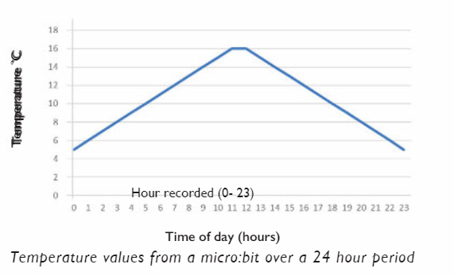
Temperature/Time Model
This graph shows the temperature data gathered using a microbit.

Slide 9
Table of data
Hour | Temp | Hour | Temp
0 | 5 | 12 | 16
1 | 6 | 13 | 15
2 | 7 | 14 | 14
3 | 8 | 15 | 13
4 | 9 | 16 | 12
5 | 10 | 17 | 11
6 | 11 | 18 | 10
7 | 12 | 19 | 9
8 | 13 | 20 | 8
9 | 14 | 21 | 7
10 | 15 | 22 | 6
11 | 16 | 23 | 5

Slide 10
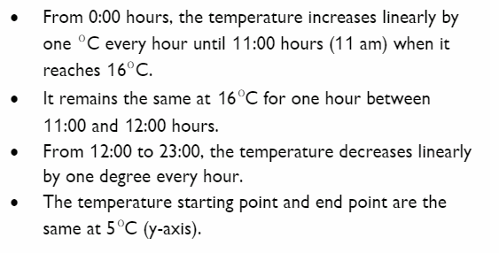
Observations

Slide 11
Developing the model
https://replit.com/@suzannelinnane/TemperatureHour-Model#main.py

Slide 12
Decision Making Model
The tennis data on the next slide can be used to model a tennis players decision to play based on weather.
It is a famous data set used for introduction to modelling.
It uses historical data to allow us to predict whether a tennis player will or not.

Slide 13
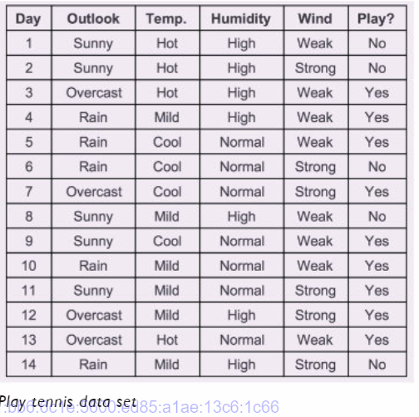

Slide 14
Tennis Model
We first need to study the data to identify scenarios.
There are four attributes involved:
Outlook
Temperature
Humidity
Wind

Slide 15
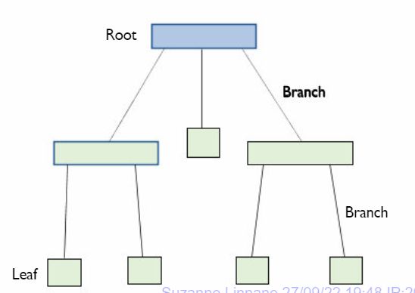
Decision Trees

Slide 16
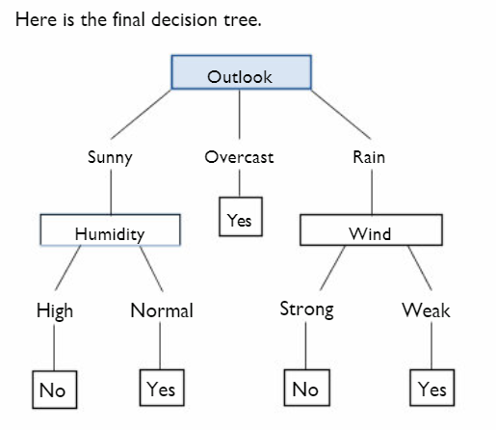
There are 14 data records but the decision making paths is just 5.

Slide 17
Tennis Model
https://replit.com/@suzannelinnane/TennisModel#main.py

Slide 18
Picking a useful model
It should be:
Messy
Real-life
Not easily solved otherwise
In the future – difficult to predict / forecast
Involve assumptions
Difficult to predict Involve probabilities / random

Slide 19
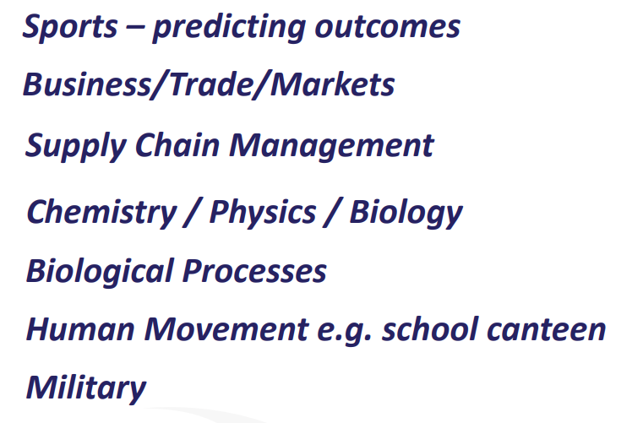
Application/Areas

Slide 20
What is modelling and simulation
https://www.youtube.com/watch?v=X-6zxImekOE
Music Video Maths
https://www.youtube.com/watch?v=DvElCxbimxc

Slide 21
Agent Based Modeling (ABM)
Agent Based Modeling is a powerful simulation modeling technique.
ABM simulates the behaviour of a complex system in which agents interact with each other and with their environment using simple local rules.
This approach has been used in the following:
predicting traffic flow in cities
analysing and predicting the spread of infectious diseases
predicting behaviour of economic systems.

Slide 22
Agent Based Modeling
Agent Based Modelling involves building models to simulate the actions and interactions of individual “agents” within an environment.
These agents are are independent of each other and the environment.
ABM allows us to simulate the behaviour of the agents to investigate how specific attributes of an agent may affect other agents or the environment as a whole.
Even a simple ABM can exhibit complex behavior patterns and provide valuable information about the dynamics of the real world system that it emulates.

Slide 23
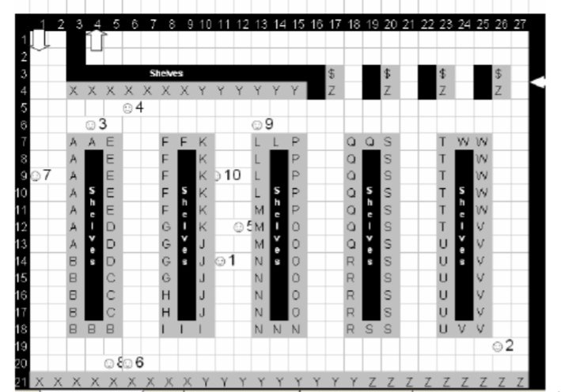
Example: Supermarket
Agents:
Shoppers
Staff
Stock
Suppliers
Checkouts
Shelves

Slide 24
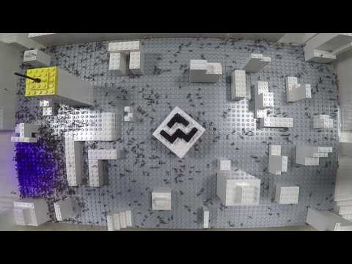
Example: Ant movement pattern
https://www.media.mit.edu/projects/ant-based-modeling/overview/

Slide 25
Example: Ant movement pattern
Each ant is an individual agent. The actions that can be taken by the ant are:
Find food and eat
Go to work
Move with other ants
The rules might be:
If the ant is hungry then the ABM will get the ant to find food
If the ant is not hungry and there is work to be done then the ant will go to work
If there is no work to do and the ant is not hungry it will join another group of ants and walk around

Slide 26
Example: Ant movement pattern
The starting conditions for the environment could be set, or generated at random.
Example:
If there is plenty of food close to an ant, it won’t take long to find food so the ant can spend more time working.
This could be used to simulate an environment when food is plentiful and widely distributed. It could be compared to the productivity when food is scarce and concentrated in one location.

Slide 27
Benefits of Agent Based Modelling
ABM can help to describe complex environments by applying a simple set of rules to each individual’s behaviour.
ABM’s can be used to test specific scenarios before they happen. This is very valuable if the outcome may be negative.
It is quite easy to work out a basic set of rules for an agent that can simulate real environments very well.

Slide 28
Emergent Behaviours
If the agent or the environment are new, an ABM can be used for simulations to examine emergent behaviours.
Example: model for commuters to see if there travel time would be reduced by a new road or traffic light system

Slide 29
Further uses of Agent Based Modelling
Biology: Tumour growth, Immune Systems (cells), Ecology for food growth
Business: Supply Chains, Sales Forecasting
Technology: Social Media usage, Logistics (truck drivers, delivery etc)

Slide 30
Coronavirus Spread
https://english.elpais.com/society/2020-10-28/a-room-a-bar-and-a-class-how-the-coronavirus-is-spread-through-the-air.htm
https://www.washingtonpost.com/graphics/2020/world/corona-simulator/
l

Slide 31
Bird patterns
https://www.youtube.com/watch?v=CPHjsWSzOY0&feature=youtu.be
Fireflies
Fireflies
https://ncase.me/fireflies/

Slide 32
Conway’s Game of Life
https://en.wikipedia.org/wiki/Conway%27s_Game_of_Life
https://playgameoflife.com/

Slide 33
Pixar
https://www.khanacademy.org/computing/pixar/simulation/hair-simulation-101/v/hair-simulation-intro

Slide 34
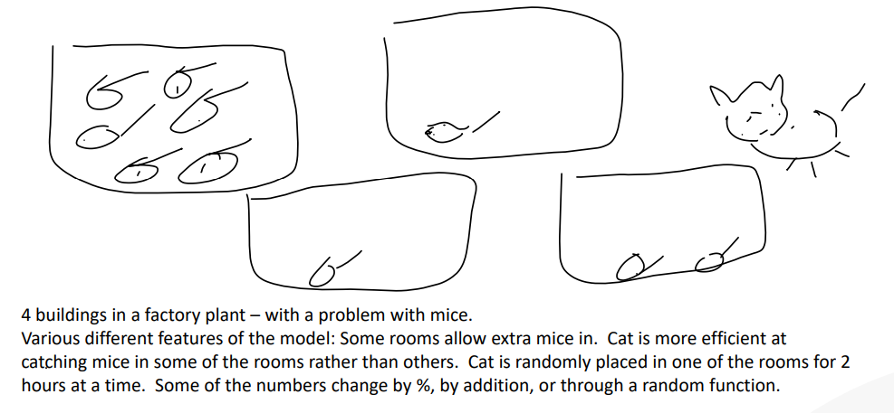
Cat and Mice

Slide 35
Population Model
Prepare a model for the increase and decrease in population of a town (you pick the town name) year by year (Births / Deaths / People leaving/arriving)
Given the following details:
Births: 3% of the population per year
Deaths 2% of the population per year
You may extend the problem:
People leaving: 3 equally likely scenarios depending on Economic factors:
1. 100 net people coming in.
2. 50 net people coming in.
3. 200 net people leaving.
Task:
Plan/write an algorithm the solution for
(i) 1 year (ii) 5 years (iii) any amount of years

Slide 36
Population Model - Setup
You will need to set a starting population (up to you what it is)
Every year this population is increased by 3% due to births
Every year this population is decreased by 2% due to deaths
Three random scenarios also affect the population (set up a list)
Find the population at the end of year 1
The population at the end of year 1 will be the starting population at the beginning of year 2

Slide 37
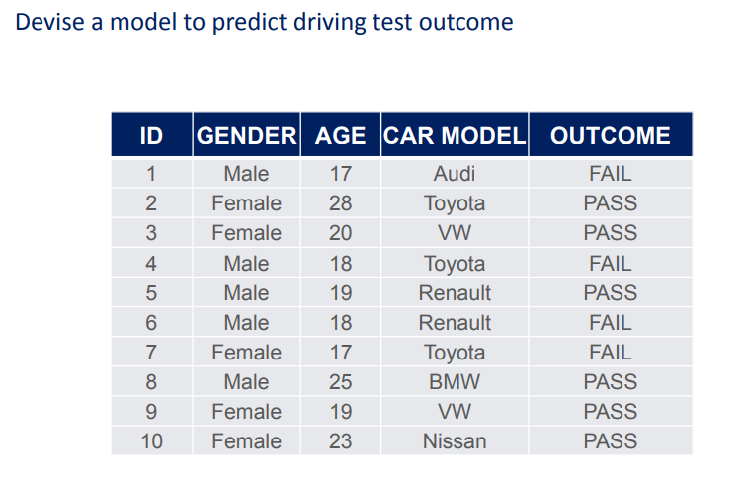
Predictive Model

Slide 38
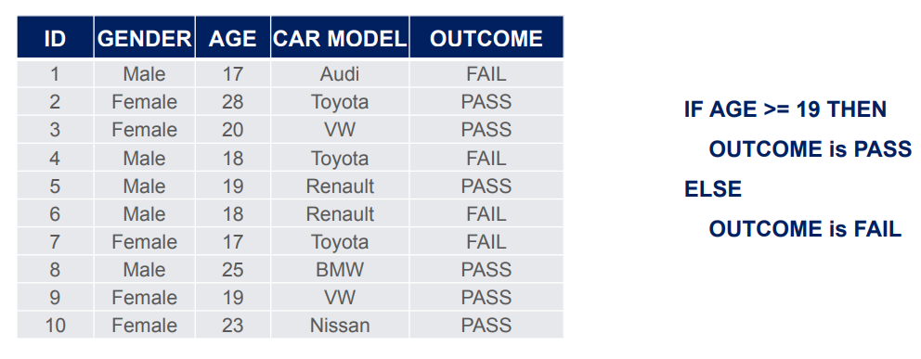

Slide 39
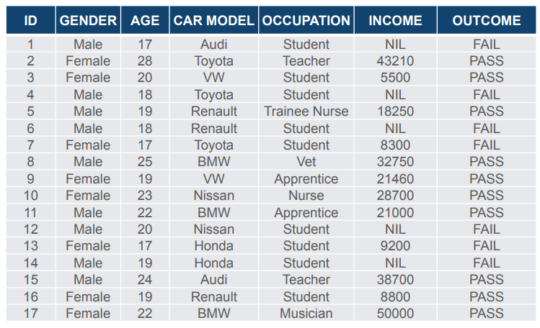

Slide 40
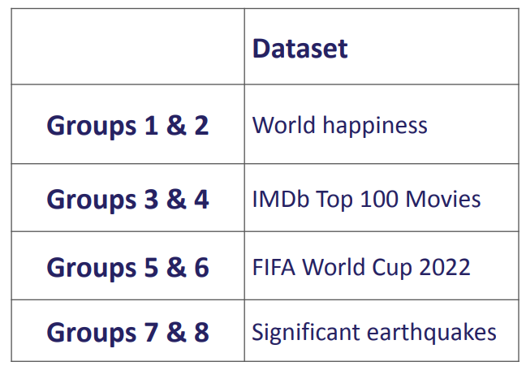
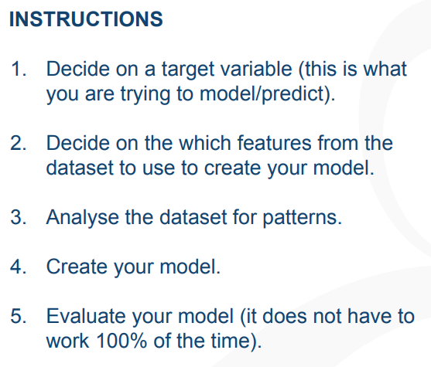
Task

Slide 41
Create a predictive model based on the data contained in the dataset you have been assigned.
World Happiness Report 2015-2019:
https://www.kaggle.com/unsdsn/world-happiness
IMDb Top 100 Movies
https://www.kaggle.com/datasets/themrityunjaypathak/imdb-top-100-movies
FIFA World Cup 2022
https://www.kaggle.com/datasets/die9origephit/fifa-world-cup-2022-complete-dataset
Significant Earthquakes 1965-2022
https://www.kaggle.com/usgs/earthquake-database

